Slide 1
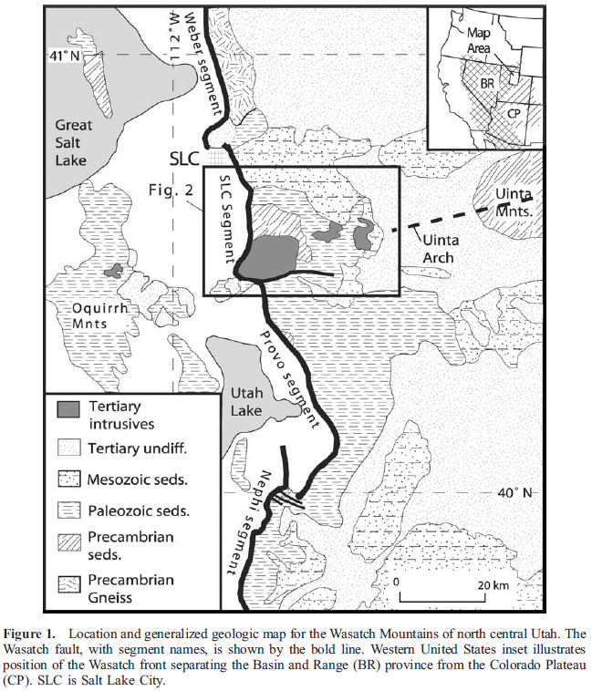
Exhumation of the central Wasatch mountains, Utah: Patterns and timing of exhumation deduced from low-temperature thermochronology data
Armstrong 2003
Geol 730 Presentation By: Neal Mankins
Carson et al. 2013

Slide 2
Purpose
Problem
Previous studies provide exhumation rates of 0.2-0.8mm/yr and 0.4mm/yr respectively but provide limited spatial variation and timing of exhumation
To understand timing, rates, and distribution of extension-related exhumation in order to understand how footwall flexure & fault growth affect extensional provinces
Method
Using apatite fission track, zircon fission track, & apatite (U-Th)/He ages from 26 samples to understand timing & style of uplift

Slide 3
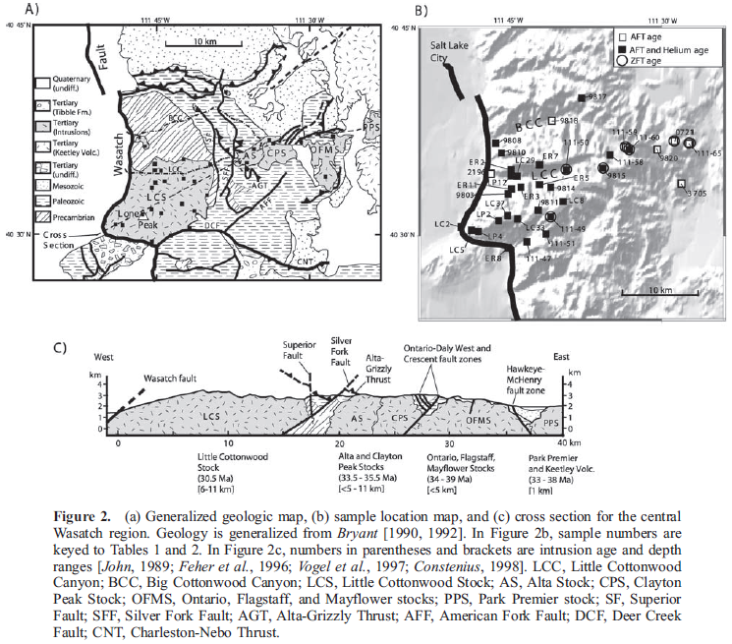
Background
Wasatch Mtns. Cover ~400km through northern Utah
Cottonwood Intrusive Belt 39-30Ma (granite-granodiorite comp.) intruded into
Mesozoic shelf
Paleozoic miogeoclinal shelf
Precambiran meta-seds
Keetley Volcanics ~36-28Ma
6 active normal faults
Wasatch is the longest & most active
Carson et al. 2013

Slide 4
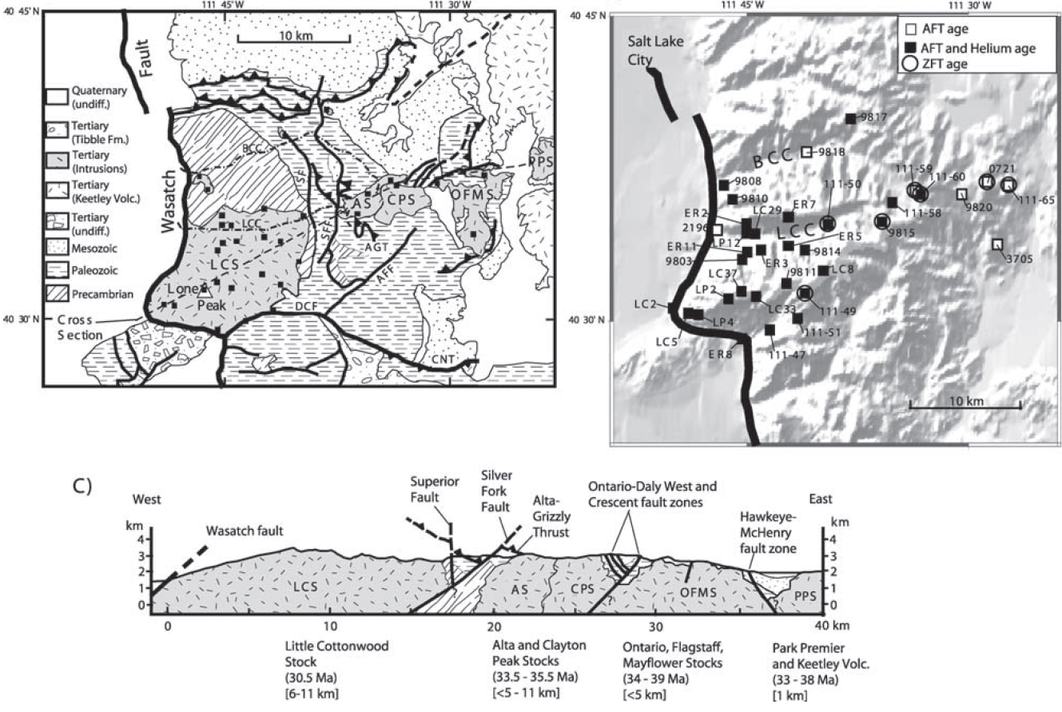
Previous Work
Intrusion emplacement depths of ~6-11km in the west & <5km in east
Wasatch tilted 15-20° causing 22km of exhumation across ~40km
Exhumation rates of 0.2-0.8mm/yr and 0.4mm/yr
2-D thermokinematic model
One tilt event or multiple?
(John, 1989)
(Evans et al., 1985)
(Naeser et al., 1983)
(Parry & Bruhn, 1986, 1987)
(Ehlers et al., 1983)
(Bryant 1990)
(John, 1989)

Slide 5
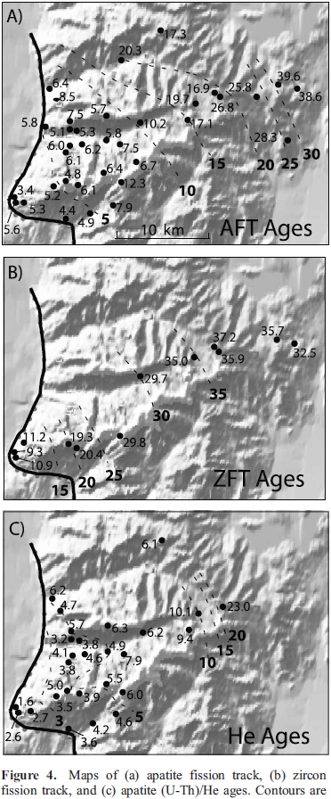
Results 1
Assuming
Using apatite closure temperatures of 65 °C
Typical geothermal gradient of 35±5°C
Temp range of 210-250°C for Zircon PAZ
(Partial Annealing Zone)
Helium retention in apatite from 40-85°C PRZ
(Partial Retention Zone)
Apatite Fission Track (AFT)
Range 3.4-39.6Ma
Increase in age to the east (5Ma at Wasatch fault to 10Ma at 15km east of fault)
Zircon Fission Track (ZFT)
Range 30-37Ma
Increase in age to the east (10Ma at Wasatch fault to 20Ma at 8km east of fault)
(U-Th)/He ages
Range 1.3-23Ma
Overall increase in age with distance from Wasatch Fault
Samples under 17km from fault underwent cooling from 150-50°C between 10-5Ma

Slide 6
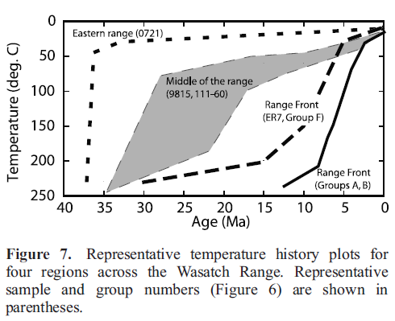
Results 11(Cooling)
Distance relative to Wasatch Fault
(U-Th)/He ages
Western Range Samples <17km
Cooling from 150-50°C between 10-5Ma
Middle range 22-26km
Cooled earlier than samples to the West
Cooling150-<100°C between 25-15Ma
Eastern range 30-35km
Rapid cooling from 40-30Ma followed by isothermal conditions <60°C
(consistent with shallow intrusion emplacement ~1km (John, 1989))

Slide 7
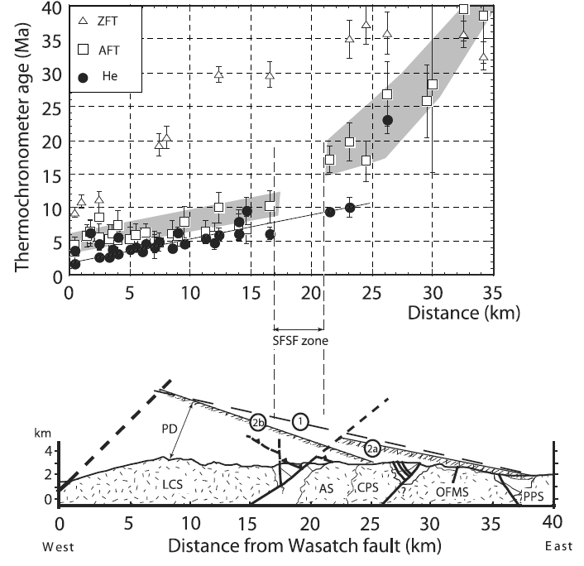
Interpretation (Paleodepth)
Assumptions
Paleogeothermal gradient of 35±5°C
Post intrusion age temperatures of <60°C
Single tilt model rejected
Western Range <17km
Calculated paleodepths of ~5.5-11km
Calculated by projecting samples below a 20° dipping surface hinge 25km east of the Wasatch fault
Middle Range (22-27km)
Calculated paleodepths down to 5.5km
Cooling related to unroofing
Calculated by projecting samples below a 15° dipping surface hinge 38km east of the Wasatch fault
Eastern Range (33-38km)
Calculated paleodepths of 1-1.5km (shallow)
Calculated by projecting samples below a 15° dipping surface hinge 38km east of the Wasatch fault
Silver Fork Superior fault system

Slide 8
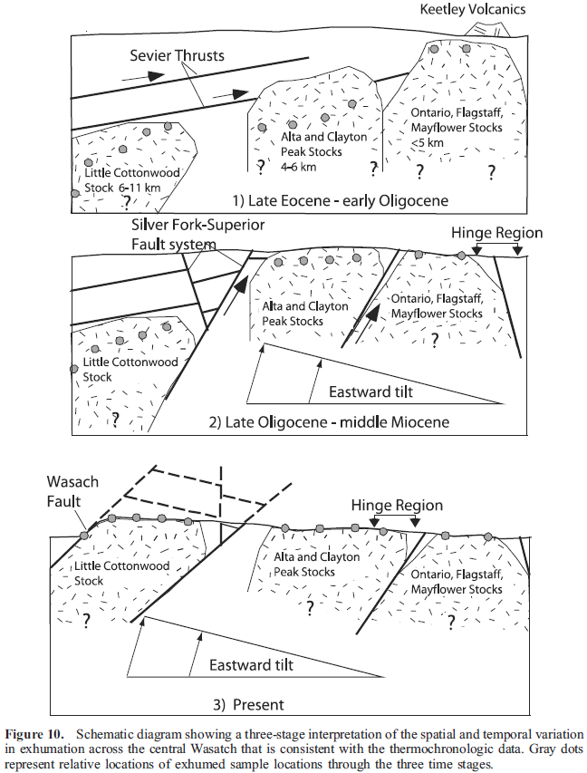
Proposed Model
Propose a two stage tilt history with eastern & middle range samples tilted by an early event and western samples tilted later
“Rolling-hinge extension model”
Assuming a paleogeothermal gradient of 35±5°C
Hinge of rotation moves West
Early Tilt (~15°)
Late Oligocene – early Miocene
Middle & Eastern samples exhumed to depths of <~1.5km corresponding with ~3.5km of erosion
Fully exhumed in last 10-12Ma during tilt event that unroofs western samples
Decrease in AFT ages to the West coincident with Silver Fork Superior fault system suggesting this system was active during unroofing
Late Tilt (~5°)
Miocene-Present
Hinge moves West prior to later tilt event
Silver Fork Superior fault system inactive by ~10Ma where displacement shifted west to Wasatch fault
~5km of differential exhumation since 10-12Ma
Tectonic unroofing dominates western 8km where surface erosion dominates the middle range

Slide 9
Conclusion
Take Home Point
2 periods of tilting in the Wasatch Mtns. related to westward migration of rolling hinge
~5km of differential exhumation
~15-20° of tilt
Silver Fork Superior fault system

